Slide 1


Using Neural Networks in Steady State Heat conduction in 2 - D
Under Guidance of
Professor P. Srinivasan
by
Somya Upadhyay
(2017B5A40962P)
Course Type :
Special Project (ME F 491)

Slide 2
Introduction and Theory

Slide 3



Equations :Steady State Equation in 2-D
Theory
Steady State Equation in 2-D
Heat Equation :
Assuming 2-D:
Steady State:
Steady state implies with no heat generation :
Therefore, for no heat generation, in 2-D Steady State for which analytical solution is available in 2 dimensions is:
;

Slide 4
Methods to solve complex partial Differential equations
Integration Techniques
Analytical methods (not possible for functions except very simplified cases that rarely occur in nature)
Finite element method (FEM)
Artificial Neural Network method (ANN)
FEM AND ANN techniques were compared to weigh their advantages and disadvantages.

Slide 5
Comparison

Slide 6
Comparison of Neural Network and Finite Element method
Reference | FEM | ANN
Solving PDE problems with uncertainty using neural-networks Yuehaw Khoo , Jianfeng Lu, Lexing Ying May 24, 2018 | Although being applicable in many situations, the computed quantity is inherently noisy due to approximation. | choosing a sufficiently large class of approximation functions without the issue of over-fitting remains a delicate business,
Hermann G Matthies and Andreas Keese. Galerkin methods for linear and nonlinear elliptic stochastic partial differential equations. Computer methods in applied mechanics and engineering | Monte-Carlo algorithm (based on FEM)’ is on one hand the strength of this approach—its general applicability, but on the other hand it does not take into account any special properties of the problem. Galerkin method’ statistics like the mean, covariance, or probabilities are very cheap.

Slide 7
Reference | FEM | ANN
,A. G. Baydin, B. A. Pearlmutter, A. A. Radul, and J. M. Siskind, Automatic differentiation in machine learning: a survey, The Journal of Machine Learning | To mitigate approximation errors in numerical differentiation, use a center difference approximation to correct error. With increasing dimensionality, a trade-off between accuracy and performance is faced. | (Automatic differentiation) allows accurate evaluation of derivatives at machine precision with only a small constant factor of overhead and ideal asymptotic efficiency. It has a two-sided nature that is partly symbolic and partly numerical. (Griewank, 2003)
Deepxde: A Deep Learning Library For Solving Differential Equations Lu Lu, Xuhui Meng, Zhiping Mao, And George Em Karniadakis | Requires a mesh to compute with dependence on the mesh shape for error/nature of result. | ‘deep learning could be a mesh-free approach by taking advantage of the automatic differentiation and could break the curse of dimensionality.’
FEM | ANN
Numerical approximations of derivatives are inherently ill-conditioned and unstable, with the exception of complex variable methods that are applicable to a limited set of holomorphic functions. (C. C. Margossian, A review of automatic differentiation and its efficient implementation, (2019), | It has accurate application in higher order PDE. In certain cases, AD libraries are implemented as black boxes which support statistical and machine learning softwares, such as the python package PyTorch (Paszke et al., 2017) or the probabilistic programing language Stan (Carpenter et al., 2017).

Slide 8
Summary
FEM | ANN
General applicability, Computed quantity is inherently noisy Galerkin method: statistics like the mean, covariance, or probabilities are very cheap. dependence on the mesh shape Applicable to a limited set of holomorphic functions. During correction, trade-off between accuracy and performance. | Initial extensive computation process. issue of over-fitting Accurate evaluation of derivatives ,only a small constant factor of overhead mesh-free approach accurate application in higher order AD libraries are implemented as black boxes No correction terms required(self correcting algorithm)

Slide 9
Problem Statement

Slide 10
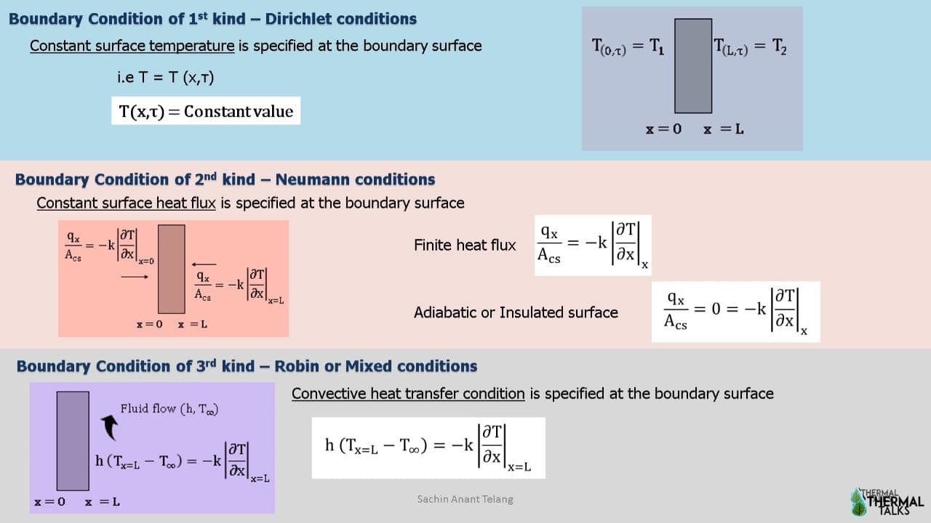
Types of Boundary Conditions

Slide 11
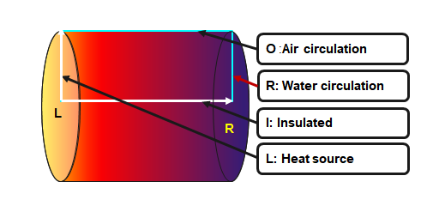
Problem statement
Figure 1:Fixed external boundaries temperature
indicative heat color map.
The Direchlet boundary condition requirement on the temperature function ψ(x,y) is given for all four edges. The steady values are based off realistic imaginary setup considering convection calculations .
L:Left wall is insulated with constant heat flux
R:Right wall has a constant coolant circulation
I:Inner wall is insulated (because it simulated the inner radial space
O:Outer wall is exposed to the environment.
(left)Ψ(r)=100 at x= 0
(right)Ψ(r)=20 at x= 2units(length)
(bottom)Ψ(x)=100 at r= 0
(top)Ψ(x)=40 at r= 1 unit(radius)

Slide 12
Heat Generation term
Constant heat generation at source up till 0.1 per cent of distance.
ė_{gen} = 100 x < 0.1 x length
k = 0 x ≥0.1 x length
Assuming cylindrical system that is symmetric about the tangential projection (azimuthal)
at a fixed radial distance(r) and fixed length (x)from the constant heat source surface (L).
The heat equation solutions are closely holomorphic (infinitely differentiable everywhere in a given domain)(Numerical study on uniformity of temperature difference field in a spiral tube heat exchanger 2021 ,Hechang Caia,b,1, Yuling Zhaib,c,1, Yao Chend,*, Fanhan Liue,*, Hua Wangb,c, Jianxin Xu)

Slide 13
Machine Learning Model

Slide 14
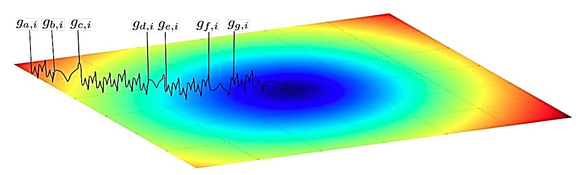
Machine Learning Model
One model was made for FEM
Two training models were made for ANN
a) Model size 1[2:32:32:1] b) Model size 2:[2:16:16:1]
Optimizer Function
The optimizer used is Adaptive Moment Estimation (Adam) optimiser. Adam uses Momentum and Adaptive Learning Rates to converge faster. The intuition for adaptive learning rates, is that we start off with big steps and finish with small steps – like mini-golf. We are then allowed to move faster initially. As the learning rate decays, we take smaller and smaller steps, allowing us to converge faster, since we don't overstep the local minimum with equally large steps.
Figure 3:Intution for Adams optimizer
(source:https://forums.fast.ai/)

Slide 15
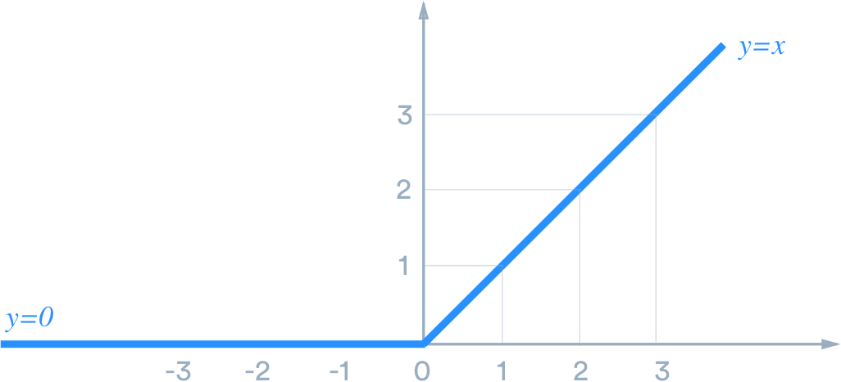
Machine Learning Model
Differential equation (r is denoted as y in the model)
Constant heat generation at source up till 0.1 per cent of distance x(energy array).
Laplace is sum of arrays dTdy and dTdx (double derivatives of T with r and x) .
Loss Function
The loss is sum of mean(diffeq) and boundary conditions.
Activation Function
It defines the output of each neuron.
The activation function used is a relu function
(rectified linear unit ) ,normalized to
values between 0 and 1 for optimizer.
Figure 2:
Relu(rectified
linear fuction)

Slide 16
Results

Slide 17
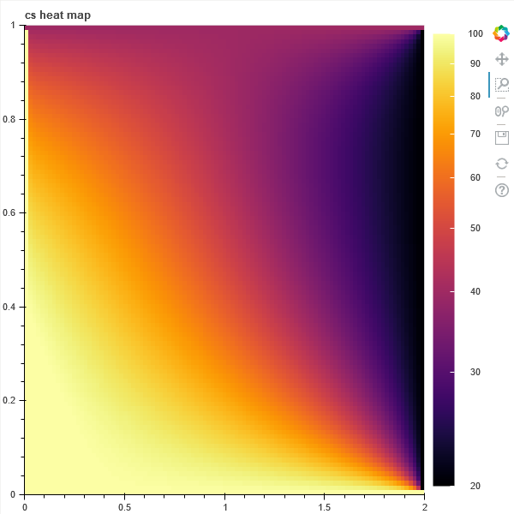
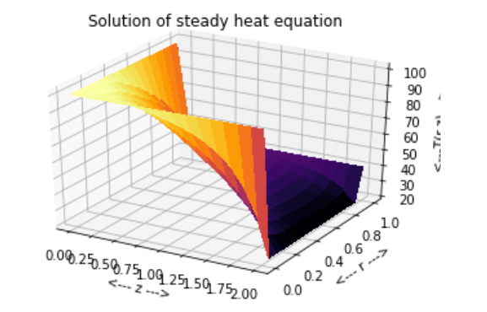
FEM
Results
Figure 4:
FEM
Mesh size= 101x101
r
X
X

Slide 18
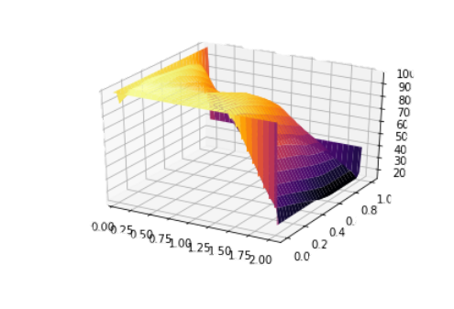
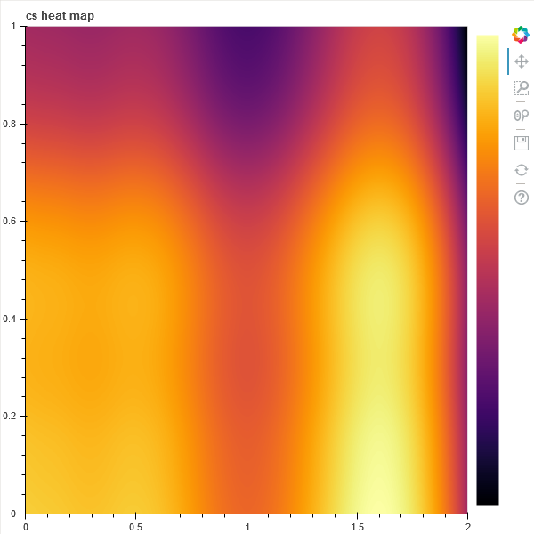
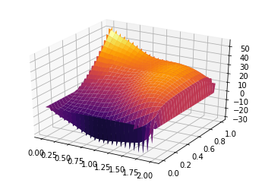
ANN
Results
Figure 5:
Grid plot using ANN
model:
Network size =[2,16,16,1]
Mesh size= 600x600
diff. eq. = 35533.50189739626
loss = 1310828.6695304194
r
Difference matrix between FEM and ANN[2:16:16:1] :
mean difference=19.578
X

Slide 19
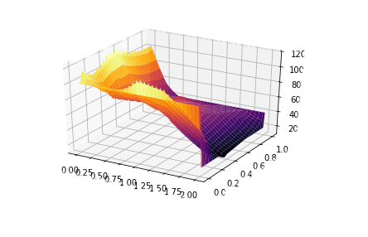
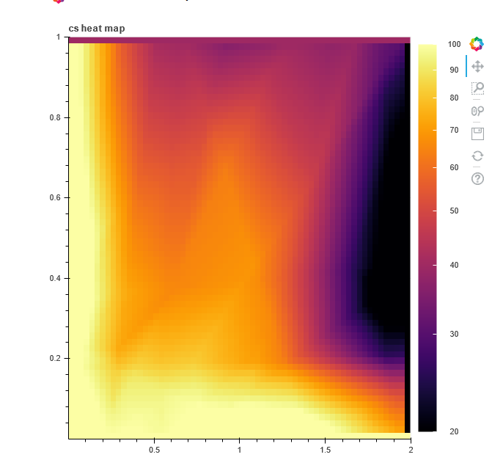
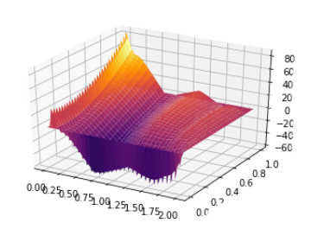
ANN (bigger network)
Figure 6:
Grid plot using ANN model:
Network size = [2,32,32,1]
Mesh size= 64x64
diff. eq.= 3533.50189739626
loss = 310028.65328
loss = 310028.65328
r
Difference matrix between FEM and ANN [2:32:32:1]:
mean difference=12.566
X

Slide 20
Heat Map
linear model [2:16:16:1]
loss =1310828.6695304194
FEM
2D array model[2:32:32:1]
Loss= 47397.776049021086
r
X

Slide 21
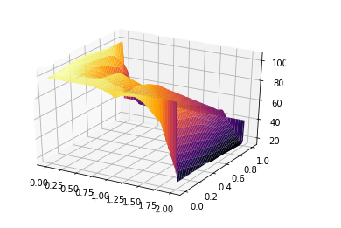
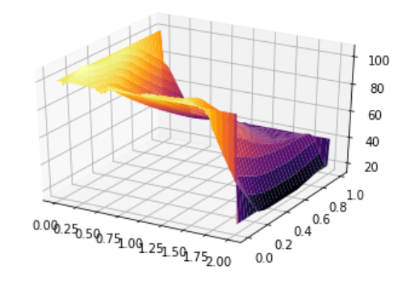
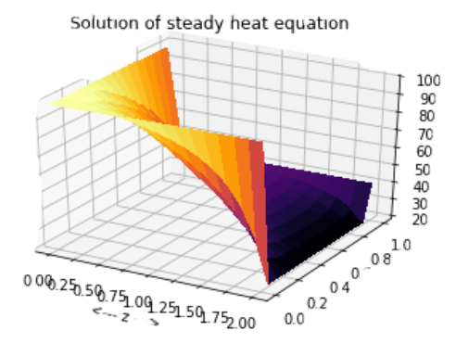
Chronology of model
linear model
loss =1310828.6695304194
2D array model
Loss= 47397.776049021086
2D array model
Loss= 40000.776049021086
FEM
2-D array after more training
loss = 310028.65328

Slide 22
Result Analysis
Mathematical Validity
Based on the Partial Differential equation, at the top left corner the FEM model misses the continuity and appears to be quickly reducing at the source. Figure 7(a) :
The ANN overestimates the results at side centres on the insulated and source side Figure 7(b) It also causes an irregular noise at the (2,0)point.
Figure 7:a)FEM inaccuracy b)ANN inaccuracy marked by blue marks.

Slide 23
*Note the grainy nature in ANN occurs because the mesh size is 64*64 compared to 601*601 for FEM.
Result Analysis
Figure 8:a)FEM inaccuracy b)ANN inaccuracy marked by blue marks.

Slide 24
Conclusion
FEM and ANN, both numerical techniques are potential candidates for likely temperature distribution. Analysing error, one can easily visualise the areas of problem.
The application for both methods is suitable in this heat conduction equation solving with different advantages. The mess-free ness of the trained weights allow s several grid dimensions to be able to adapt to the equation and generate point solutions with minimal error. However the initial processing time for the FEM and flexibility in choosing dimensions (symmetrical along each dimension) make it suitable for lower complexity heat generation function. For more complex heat generation function the ANN model becomes cheaper and give less approximate error according to above study. These conclusions validate and support claims that ANN is an accurate and precise alternative to FEM.
The error for moderate training indicate for ANN model strictly follows boundary condition with less approximation error than visible in FEM model. However, local regions of abnormal gradients and non-linearly that are impractical also occur in the central region of the plot that cannot be justified theoretically.
While the errors in FEM model are inherent and can be reduced at the cost of memory and time taken t process in each run. The errors have a scope for improvement in ANN with parameter optimisation experimenting with different model sizes and activation functions. For more complex shapes used in solvers like Ansys the intricate shapes can be application for ANN with lower long run cost.

Slide 25
Appendix
Link to final code :
https://github.com/somyaup/2-D-steady-state

Slide 26
References
Solving PDE problems with uncertainty using neural-networks ,Yuehaw Kho, Jianfeng Lu , Lexing Ying, May 24, 2018
Hermann G Matthies and Andreas Keese. Galerkin methods for linear and nonlinear elliptic stochastic partial differential equations. Computer methods in applied mechanics and engineering, 194(12):1295–1331, 2005.
A. G. Baydin, B. A. Pearlmutter, A. A. Radul, and J. M. Siskind, Automatic differentiation in machine learning: a survey, The Journal of Machine Learning Research, 18 (2017), pp. 5595–5637.
C. C. Margossian, A review of automatic differentiation and its efficient implementation, Wiley Interdisciplinary Reviews: Data Mining and Knowledge Discovery, 9 (2019), p. e1305
Why does deep and cheap learning work so well?∗ Henry W. Lin, Max Tegmark, and David Rolnick 2017
Zhang, Qi, Chen, Yilin,Yang, Ziyi,(2020/06/21), Data-driven solutions and discoveries in mechanics using physics informed neural network
A deep learning library for solving differential equations Lu Lu, Xuhui Meng, Zhiping Mao, And George Em Karniadakis
1608.08225
A. G. Baydin, B. A. Pearlmutter, A. A. Radul, and J. M. Siskind, Automatic differentiation in machine learning: a survey, The Journal of Machine Learning Research, 18 (2017), pp. 5595–5637.
C. C. Margossian, A review of automatic differentiation and its efficient implementation, Wiley Interdisciplinary Reviews: Data Mining and Knowledge Discovery, 9 (2019), p. e1305.
Why does deep and cheap learning work so well?∗ Henry W. Lin, Max Tegmark, and David Rolnick 2017
Analysis of Steady State Heat Conduction Problem Using EFGM Manpreet Singh Brar1, Sunil Kumar2 1M.Tech Student, 2Assistant Professor Department of Mechanical Engineering, International Journal of Engineering and Management Research, Vol.-2, Issue-6, December 2012
Fabio Tokio Mikki1, Edison Issamoto1, Jefferson I. da Luz1,Pedro Paulo Balbi de Oliveira1, Haroldo F. Campos-Velho2,Jose Demisio Simoes da SilvaA NEURAL NETWORK APPROACH IN A BACKWARD HEAT CONDUCTION PROBLEM. Brazilian Conference on Neural Networks - IV Congresso Brasileiro de Redes Neuraispp. 019-024, July 20-22, 1999
Wagner Barbosa Muniz a, Haroldo F. de Campos Velho b, Fernando Manuel Ramos b,A comparison of some inverse methods for estimating the initial condition of the heat equation
received 29 October 1997; received in revised form 23 December 1997
Dejan M. Boˇskovic ́, Miroslav Krstic ́, and Weijiu Liu, Boundary Control of an Unstable Heat Equation ViaMeasurement of Domain-Averaged emperature, IEEE TRANSACTIONS ON AUTOMATIC CONTROL, VOL. 46, NO. 12, DECEMBER 2001
Numerical study on uniformity of temperature difference field in a spiral tube heat exchanger 2021 ,Hechang Caia,b,1, Yuling Zhaib,c,1, Yao Chend,*, Fanhan Liue,*, Hua Wangb,c, Jianxin Xu)

Slide 27
Thank You

